Slide 1
How Archivists Could Stop Deep Fakes from Rewriting History By Melanie Ehrenkranz
https://gizmodo.com/how-archivists-could-stop-deepfakes-from-rewriting-hist-1829666009
Presentation: Justin Whitlock
14 April 2019

Slide 2
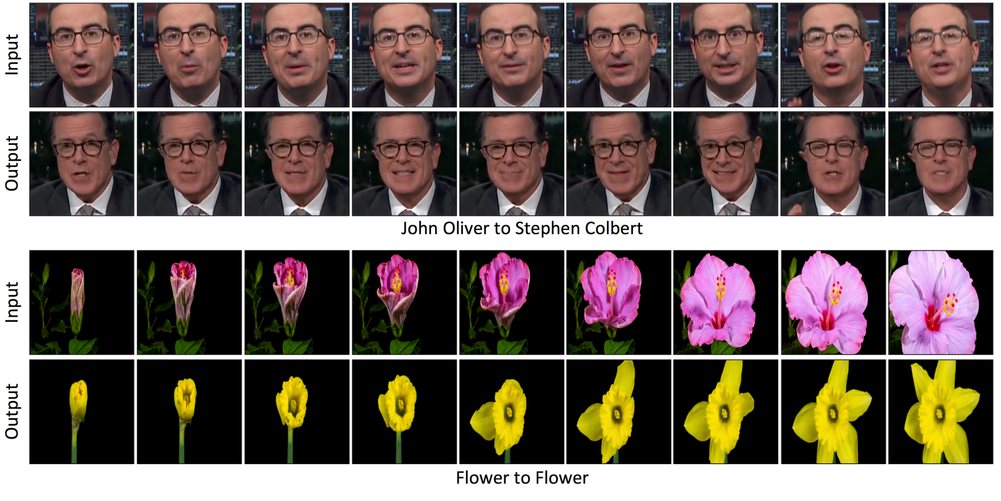
Deep Fakes are sometimes easy to spot
https://youtu.be/ehD3C60i6lw

Slide 3
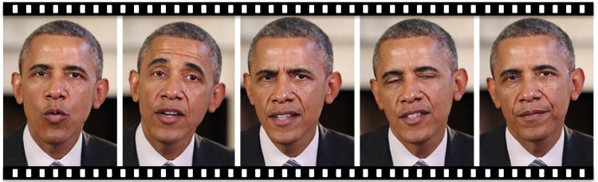
Deep Fakes are becoming more convincing
This research maps facial expressions and mouth movements to video of Barack Obama, using recorded audio to create fake videos that look almost legitimate.
https://youtu.be/9Yq67CjDqvw

Slide 4
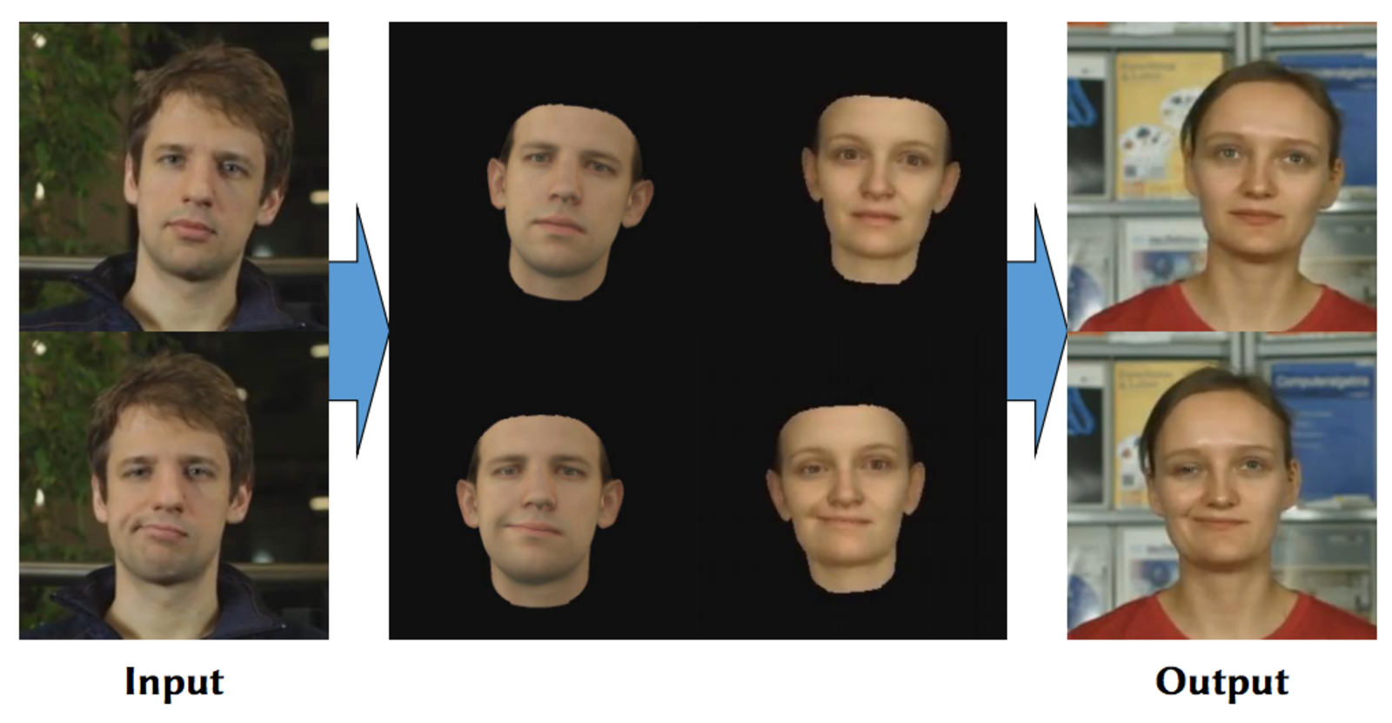
An improvement which includes adjusting the head motion to match dialogue.
https://youtu.be/qc5P2bvfl44

Slide 5
Concern over Deep Fakes is two-fold
Prolific generation of misinformation in an attempt to influence current events
The spread of fake news on social media.
Election meddling by foreign powers.
Insertion of false documents into the historical record as factual accounts.
How do archivists ensure that Deep Fakes are labeled as such?
How to prevent bad actors from tampering with archival records by inserting Deep Fakes into the record or changing the provenance of known Deep Fakes?

Slide 6
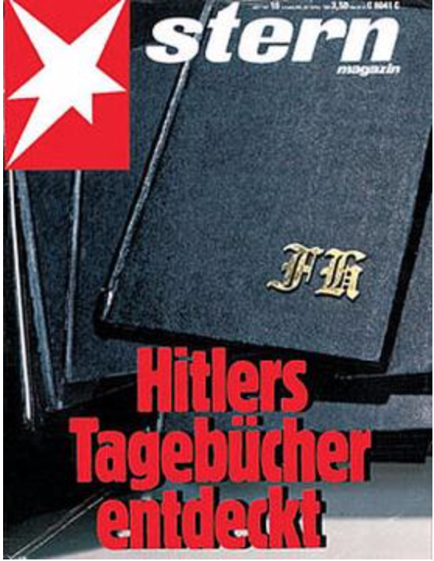
History is full of fakes; The Hitler Diaries, 1983
“An archive of great historical significance” - Hugh Trevor, UK historian, retracted almost immediately.
Forgeries, penned by Konrad Kujau, a man with a history of falsifying Nazi Memorabilia
60 volumes forged between 1981 and 1983.
https://en.wikipedia.org/wiki/Hitler_Diaries

Slide 7
What if the Hitler Diaries entered the historical archive as accepted fact? Why?
Historical Negationism:
The purposeful distortion of the historical record to support a specific ideology or political cause.
“...presenting known forged documents as genuine,
inventing ingenious but implausible reasons for distrusting genuine documents,
attributing conclusions to books and sources that report the opposite,
manipulating statistical series to support the given point of view,
deliberately mis-translating texts (in languages other than the revisionists).”
Wikipedia contributors. (2019, April 13). Historical negationism. In Wikipedia, The Free Encyclopedia. Retrieved 17:55, April 14, 2019, from https://en.wikipedia.org/w/index.php?title=Historical_negationism&oldid=892348289

Slide 8

One of the most famous examples of Negationism
1984
Published in 1949
World history is erased.
History is then fabricated by the Ministry of Truth to support the narrative of a totalitarian government.
Inspired vernacular:
Orwellian
Big Brother
Double Think
Memory Hole

Slide 9
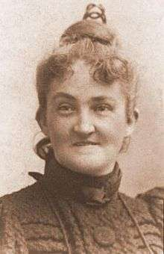
Lost Cause: Mis-remembering the American Civil War
Reframing of the Civil War as a conflict over states rights, downplaying the role of slavery as a factor in the formation of the Confederacy.
Recasting of Confederate leadership as being against slavery.
The idea that Robert E. Lee was against the institution of slavery.
Describing the Reconstruction government as ineffectual because of Federal mismanagement.
In Reality: Undermined by white militias who terrorized and assassinated lawmakers.
Federal government did very little to back up the Reconstruction government.
Paint Jim Crow laws as well meaning attempts to protect black Americans by keeping them seperate.
Downplaying the atrocities of chattel slavery.
Generally just romanticizing the Confederacy as “Southern Heritage”.
MIldred Lewis Rutherford
(1851-1928)

Slide 10
Every atrocity has its negationists
Holocaust Denial: Dismiss historical accounts of the extent of the Holocaust as either exaggeration, or that it is entirely fiction; Particularly the use of gas chambers.
Armenian Genocide: Turkey denies there was a genocide, while Pakistan denies the existence of Armenia. United States refuses to take an official position on the matter.
Japanese War Crimes: Ultranationalists wrote a number of school textbooks denying or omitting many events involving war crimes committed by the Japanese government prior to and during WWII.
http://bit.ly/2KDU40n Turkey
https://bbc.in/2UFVQCR U.S.
http://bit.ly/2GmZGru Pakistan
https://stanford.io/2Uyvz9k Japan

Slide 11
How to circumvent negationism?
Days of Remembrance:
Many EU nations hold a day of remembrance for the Holocaust and Armenian Genocide.
Legal Action:
Germany, France, Belgium, Spain, and Austria have made negationism a crime.
Education:
Ensuring that textbooks do not exclude the ugly details behind many historic events.
If you leave a vacuum it will get filled with something.
Thorough documentation that is
Available to the public.
Its provenance is transparent.
Past errors are carefully recorded
Fronza, Emanuela. "The punishment of negationism: the difficult dialogue between law and memory." Vt. L. Rev. 30 (2005): 609.
Bloch, Pascale. "Response to Professor Fronza's The Punishment of Negationism." Vt. L. Rev. 30 (2005): 627.
Teachout, Peter R. "Making Holocaust Denial a Crime: Reflections on European Anti-Negationist Laws from the Perspective of US Constitutional Experience." Vt. L. Rev. 30 (2005): 655.

Slide 12
How can archivists circumvent tampering?
Lots and lots of copies.
LOCKSS: Lots Of Copies Keep Stuff Safe
Stanford Web Archiving Program’s guiding principle.
Changes are evident by comparing the copies to each other.
An attacker would need to change ALL of the copies at ALL of the archives at the same time for changes to go unnoticed.
“We want to build systems where tampering is evident and it prompts alerts...We want to build a system where the integrity of the information is determined by the consensus of peers.” ~Nicolas Taylor, Program Manager, LOCKSS
https://www.lockss.org

Slide 13
Using fixity to ensure data has not been changed
Checksums:
When transferring files, checksums are used to ensure the file has been received correctly
They can also be used to determine whether a file has changed since it was created.
Manifest
A document which maintains the fixity of a digital artifact on a certain date.
Make multiple copies of the manifest!
Push the manifest fixity records to multiple archives.
https://www.slideshare.net/phonedude/weaponized-web-archives-provenance-laundering-of-short-order-evidence-93083713

Slide 14
Forensic evidence can help determine what is real
Yvonne Ng at WITNESS compares the Deep Fake issue with traditional methods of determining authenticity of paintings.
Materials used.
Objects in the picture.
Setting of the picture, rooms, buildings, architecture.
All of these can help determine when a painting was made, or when it definitely was not made.

Slide 15
Traditional forensics also apply to digital resources
Similar techniques can be used to authenticate the provenance of a particular digital record.
Method of creation.
Objects in the frame
Say, Barack Obama is wearing a pin given to him by the Queen of England, but the video is portrayed as happening BEFORE she gave it to him.
Background, Decor, etc.
White House regularly undergoes redecoration.
Buildings get repainted, torn down, etc.
Language used. Particularly phrases that were not in use at the time of the video’s supposed creation.
These tools can help determine a range for when something was created, but also when something could not have been created.

Slide 16
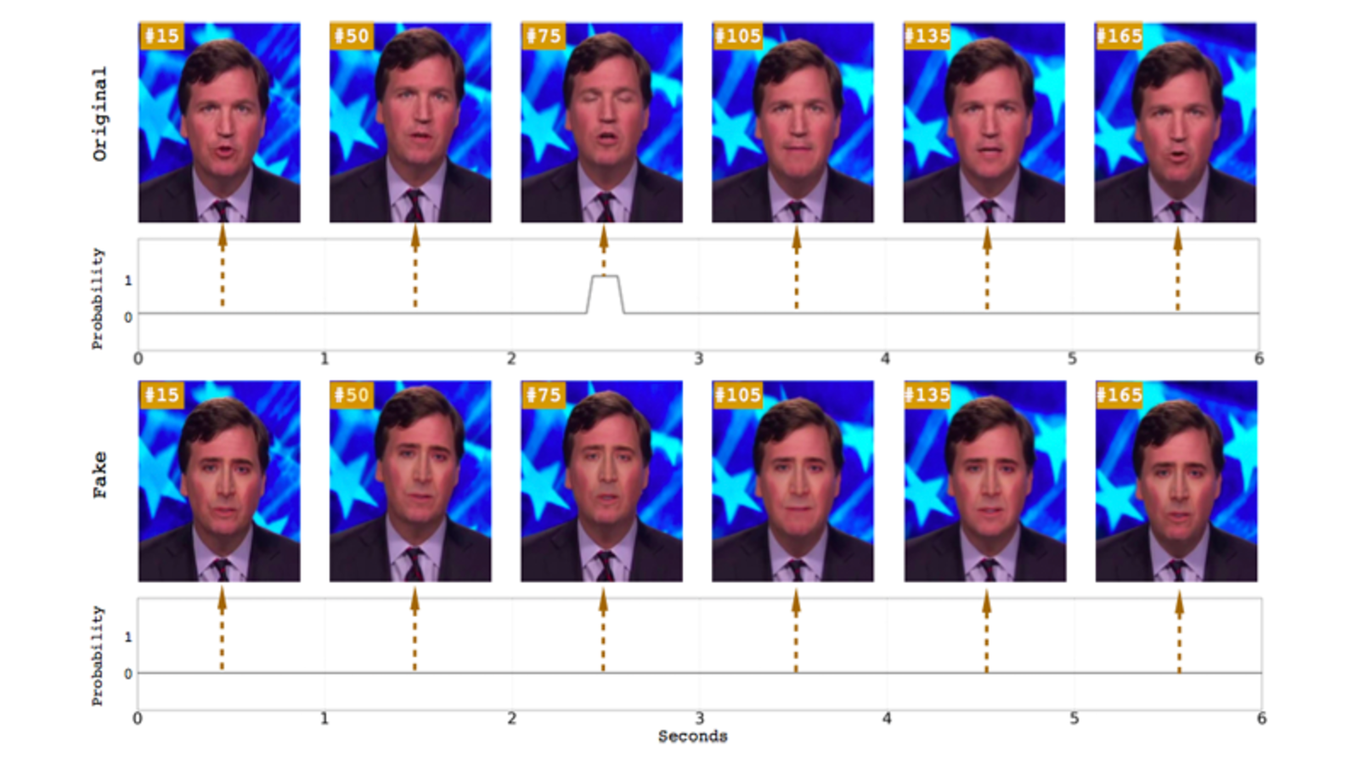
Machine learning can be used to spot the fakes created by machine learning
Researchers were able to spot Deep Fakes by detecting the number of eyeblinks.
Li, Yuezun, et al. "In ictu oculi: Exposing ai generated fake face videos by detecting eye blinking." arXiv preprint arXiv:1806.02877 (2018).

Slide 17
Most institutions are more concerned with preservation
Data preservation over long periods of time requires a certain degree of foresight in the here and now.
Natural disasters
Bit rot
Environmental threats
Obsolescence of hardware or software

Slide 18
Redundancy could serve both purposes
More copies means more of a chance of survival for data and physical objects.
In the post apocalypse, Dean Koontz, Danielle Steele, and Louis L’Amour will be well remembered.
Carefully recording and labeling the Deep Fakes in multiple archives can ensure that future generations understand the context in which a Deep Fake was generated.
More copies can also help in cases of bit rot, or other forms of data loss.
Fixity manifests can help maintain provenance as well as alert to changes due to bit rot or data loss.

Slide 19
Archives can police each other
Push documents to multiple archives.
Record fixity at time of push.
Push fixity of documents to multiple archives.
If a document is changed or damaged
Fixity will show which documents have been changed.
If fixity doesn’t agree, multiple copies can help determine which fixity manifest is most likely original.
https://www.slideshare.net/phonedude/weaponized-web-archives-provenance-laundering-of-short-order-evidence-93083713

Slide 20
Take Away:
Archivists already have some defense against Deep Fakes.
Forensic tools.
Careful documentation of previous fakes.
The tools used to create Deep Fakes can also be used to combat them.
Machine learning can be leveraged to spot Deep Fakes.
Redundancy and fixity can serve both the need for clear documentation of provenance, and data preservation.
Archives can essentially police each other through consensus.

